Slide 1
Corona tweet classification system
BACHELOR OF COMPUTER APPLICATIONS
Presented By: Ahmad Faraz Ansari (B.C.A. 6th Sem)
Batch Year: 2019 - 22

Slide 2
Introduction
Corona Tweet Classification System is a machine - learning based tweet classification system.
Developed entirely using Python 3 for platform-independency.
Classification is done using SVM algorithm.
Proposed System can classify tweets based on the underlying emotion i.e., whether tweet is covid-positive or covid-negative.

Slide 3
objective
Creating a system that can classify tweets using machine-learning.
Classification of tweets is to be done on the basis of severeness of the underlying emotion.

Slide 4
Methods utilized - 1
1. EDA (Explanatory Data Analysis):
Tasks to be achieved are :
Class distribution.
Calculating the length of the tweet to get average length of tweet.
Basic pre-processing (dataset cleaning).
Removing common stop-words (redundant words).

Slide 5
Methods utilized - 2
2. Technique:
Tweet Classification using SVM (Support Vector Machine)
Python Libraries: pandas, numpy, ntlk, sklearn, matplotlib, re, string

Slide 6
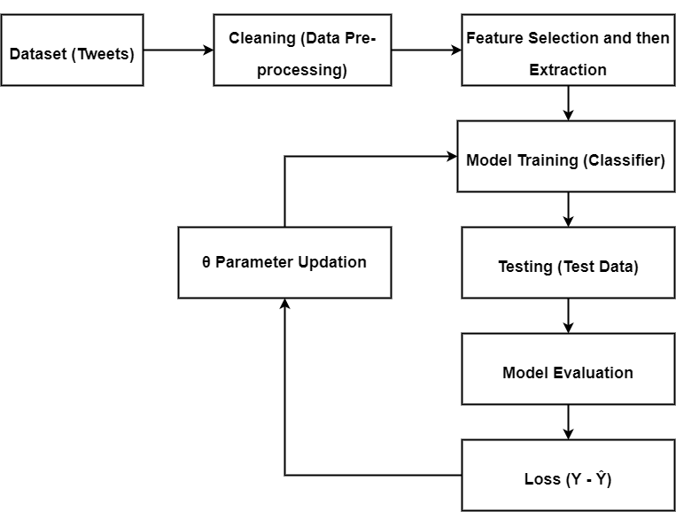
Machine learning pipeline diagram

Slide 7
Contents
Requirements import
Loading dataset
Pre-processing (cleaning of dataset)
Splitting of the dataset
Tokenization
Lamentization
Features extraction
Modelling using SVM (Support Vector Machine)
Evaluation metrics

Slide 8
references
https://app.diagrams.net/
Kaggle.com/pre-processing-in-NLP
Kaggle.com/sentiment-analysis-using-logistic-regression
Documentation of all python libraries used

Slide 9
Thank you!

Slide 10
Any questions? feel free to ask them.

